Slide 1
Which Email Marketing Software Is The Best?
Know the exact platform you need to start converting more customers

Slide 2


What is email marketing?
Email marketing is a method of marketing your products or services to existing customers or customers who have interacted with your brand before.

Slide 3
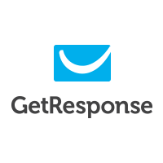

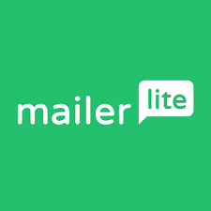


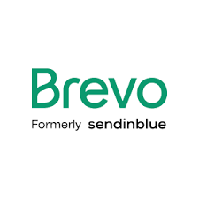
What are your options?

Slide 4
What do you need to look for?
Especially for a beginner, the things you need to look for are:
Deliverability
Free plan usage benefits
Easy to navigate

Slide 5
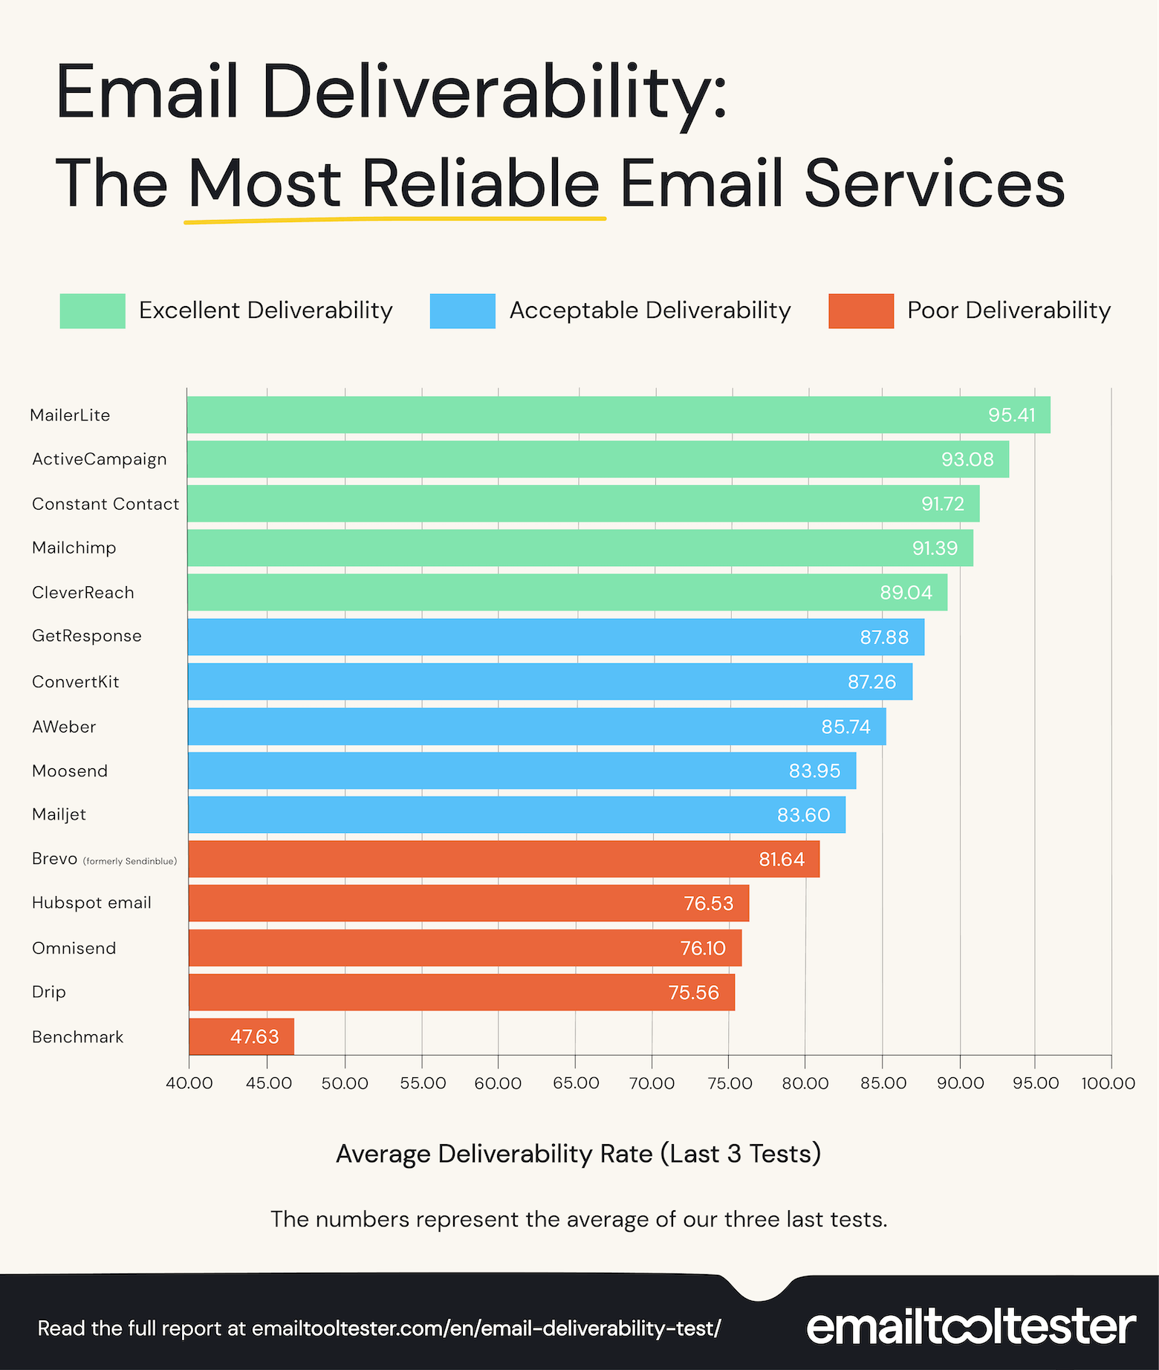
Deliverability
As of AUGUST 2023

Slide 6
Free plan benefits
 | MONTHLY EMAILS | SUBSCRIBER LIMIT | FREE PLAN?
MailerLite | 12,000 | 1,000 | Yes
MailChimp | 1,000 | 500 | Yes
GetResponse | 2,500 | 500 | Yes
HubSpot | 2,000 | 1,000,000 | Yes
Active Campaign | No free plan | No free plan | No
Brevo | 9,000 | Unlimited | Yes

Slide 7
Which ones are easy to navigate and use?
MailerLite or Brevo takes my pick here.
MailerLite is what I personally use, the deliverability is superb (one of, if not the best). It’s really easy to navigate around and use to a good effect.
Ones I would avoid as a beginner:
ActiveCampaign - Designed for advanced users, the interface is for experienced email marketers.
MailChimp - In my own experiences, this platform’s interface is horrible to use, it’s way too confusing for a beginner.

Slide 8
What Would My Pick Be?
My pick would be MailerLite.
Reliable and consistent deliverability
Good free plan features with plenty of monthly emails and subscriber limits
Super easy to navigate around

